Slide 1

Federated Learning Intrusion Detection System
by
B.PRANATHI
Roll No. 224G1A0571
T.JOSHIKA
Roll No. 234G5A0504
C.KRISHNAKOWSHIK
Roll No. 224G1A0538
Under the guidance of
Dr. S.Ravi Kumar, M.Tech., ph.D.
Assistant Professor
Department of Computer Science and Engineering
Srinivasa Ramanujan Institute of Technology
Autonomous
Rotarypuram Village, B K Samudram Mandal, Ananthapuramu – 515701.
2025-2026

Slide 2
Contents
Federated learning Intrusion Detection System
Title Justification
Abstract
Problem statement
Objectives of Project
Literature survey for objectives
Proposed Work -(Methods to be followed for proposed system)
References
GitHub Link
Queries
Srinivasa Ramanujan Institute of Technology

Slide 3
Title Justification
Federated learning Intrusion Detection System
The title “Federated Learning–Based Intrusion Detection System” is appropriate because the project combines two key concepts:
Federated Learning – allows multiple cloud or network nodes to collaboratively train a machine learning model without sharing raw data, ensuring privacy and security.
Intrusion Detection System (IDS) – monitors network traffic and system activity to detect malicious attacks, anomalies, and threats in real time.
Since your project focuses on detecting cyber threats while preserving user data privacy, this title clearly represents both the technology used (Federated Learning) and the purpose (Intrusion Detection).
Srinivasa Ramanujan Institute of Technology

Slide 4
Abstract
Federated learning Intrusion Detection System
The Federated Learning – Intrusion Detection System is designed to secure cloud environments in a collaborative and efficient way. It allows multiple cloud clients to train threat detection models locally, while a central server aggregates updates to build a stronger global model. The system protects sensitive data by keeping it private, detects attacks like malware and intrusions quickly, and reduces manual monitoring through automated alerts and adaptive learning. Overall, it makes cloud security smarter, faster, and more privacy-compliant for both providers and users.
Srinivasa Ramanujan Institute of Technology

Slide 5
Problem Statement
Federated learning Intrusion Detection System
“Traditional IDS systems require centralizing security logs, which exposes sensitive user data and violates privacy regulations. With increasing cyber-attacks in cloud platforms, there is a need for a secure IDS that can detect threats without sharing raw data. This project develops a Federated Learning-based Intrusion Detection System (FL-IDS) that allows multiple cloud nodes to collaboratively train a threat-detection model while keeping all sensitive data local, ensuring both strong security and privacy preservation.”
Srinivasa Ramanujan Institute of Technology

Slide 6
Objectives of Project
Federated learning Intrusion Detection System
Objective 1:
To design a federated learning framework that enables multiple cloud clients to collaboratively train threat detection models without sharing raw data.
Objective 2:
To enhance cloud security and privacy by automating threat identification, anomaly detection, and alert generation while ensuring compliance with data protection regulations.
Srinivasa Ramanujan Institute of Technology

Slide 7
Federated learning Intrusion Detection System
Literature Survey
No | Title | Author | Journal Name & Year | Methodology Adapted | Key Findings | Gaps
1. | Federated Learning-Based Intrusion Detection System for Cloud Networks | Q. Li & Y. Chen | IEEE Transactions on Network and Service Management, 2023 | Implemented FL architecture where multiple cloud nodes train local IDS models | Improved detection accuracy without sharing raw data; reduced privacy risk; scalable in cloud environments | No adversarial attack defense; high communication
2 | Secure Federated Learning Framework for Distributed Cyberattack Detection | J. Kaur & P. Sharma | Int. Journal of Cyber Security and Digital Forensics, 2022 | Proposed secure FL framework using encrypted parameter updates for distributed IDS | Enhanced security of model training; improved robustness against data breaches; suitable for distributed networks | No evaluation against poisoning attacks; limited dataset diversity; no automation or self-healing mechanisms
B -15

Slide 8
Proposed System
Federated learning Intrusion Detection System
The proposed system is a federated learning–based framework designed to detect cloud threats in a secure and privacy-preserving way. The system allows multiple cloud clients to train models locally on their own sensitive data, while a central server aggregates updates to build a stronger global detection model. Instead of sharing raw logs or private information, all threat-related learning takes place collaboratively across distributed nodes. This makes detection faster, more accurate, and compliant with privacy regulations. The system also provides automated alerts, anomaly detection, and resilience against adversarial attacks, making cloud threat detection more efficient, transparent, and trustworthy for both providers and users.
Srinivasa Ramanujan Institute of Technology

Slide 9
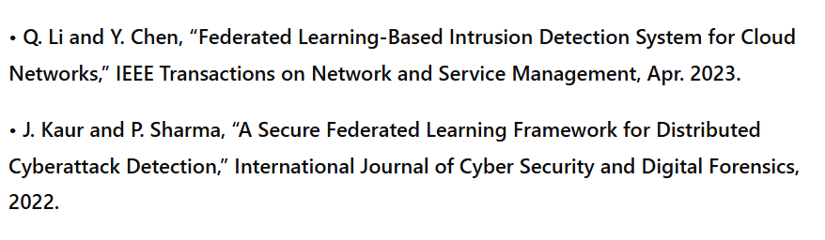
References
Federated Learning Intrusion Detection System
Srinivasa Ramanujan Institute of Technology

Slide 10
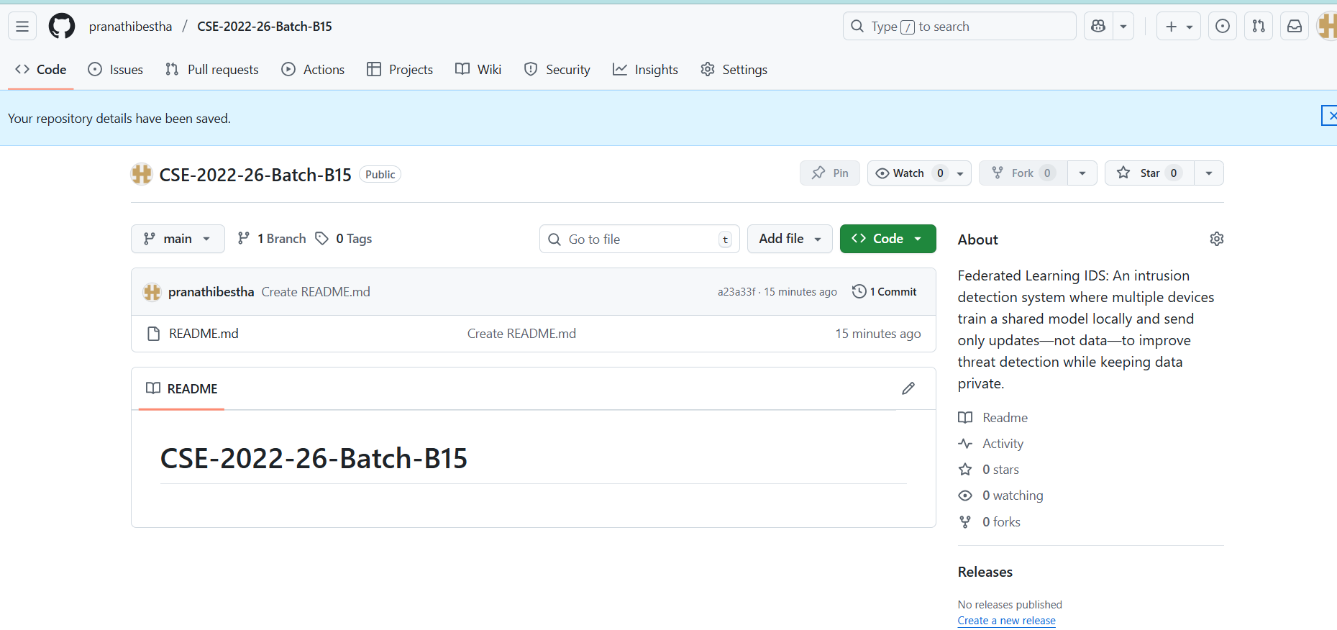
Git Hub Dashboards of each student
Federated Learning Intrusion Detection System
link of the Github : https://github.com/pranathibestha/CSE-2022-26-Batch-B15
Srinivasa Ramanujan Institute of Technology

Slide 11
Any Queries?
Federated Learning intrusion Detection System
Srinivasa Ramanujan Institute of Technology

